Slide 1







UNIX
Lets all enter into the UNIX Universe
UNIX
Lets all enter into the UNIX Universe
Wish You A Happy and Informative Journey!!!
Knowledge grows by sharing

Slide 2

UNIX
Introduction to Operating systems
Need of an Operating system
Services that an Operating system provides
Single user and multi user Operating system
Introduction to UNIX
Benefits of UNIX
Features of UNIX
What makes UNIX unique
UNIX architecture
The UNIX “Shell”
Getting started in UNIX…..
Basic commands
Agenda
Knowledge grows by sharing

Slide 3






UNIX
Enjoying work
Operating system needs to be reloaded!
"Operating system"
What is it?
Provides all basic services to the user….
Knowledge grows by sharing

Slide 4

UNIX
Is an “interface” between the user and the hardware
Is the “first” program that is loaded into the memory when the system is switched on
Creates a working environment for the user
Can be looked upon as enveloping the hardware
"Operating system"
What is it?
The user’s desire is the command for the operating system .
Knowledge grows by sharing

Slide 5
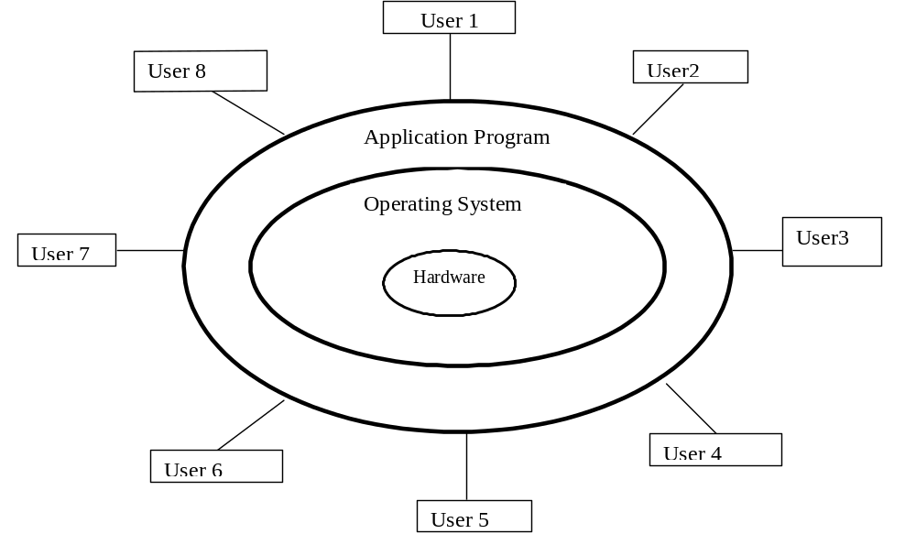
UNIX
Hardware
Operating System
Components
of a
computer system
Application programs
User
Operating system is the “mediator “ between the user and the machine
Knowledge grows by sharing

Slide 6




UNIX
Functions of an OS
Functions of
an
Operating System
All the tasks done by an OS can be categorized under the above functions
Knowledge grows by sharing

Slide 7

UNIX
Single User
    Example -DOS
Multi User
    Example-Windows,Unix
Two main types
of an
Operating system
Knowledge grows by sharing

Slide 8
UNIX
Handle the tasks of multiple users simultaneously
Handle the sharing of common resources like printers and disks by a number of users
Handle communication between the multiple users working
Need of a
Multiuser
Operating system
To handle multiple users efficiently….a multi user OS is essential.
Knowledge grows by sharing

Slide 9



UNIX
Features of a multi-user OS
Features of a
Multi User OS….
Knowledge grows by sharing

Slide 10

UNIX
Is the most popular OS on multi user systems
Is a program coded in ‘C’ language that turns the computer into a useable machine
MS-DOS was created much later than UNIX
  Currently available on machines ranging from PCs to Cray supercomputers
Introduction to
UNIX
Knowledge grows by sharing

Slide 11

UNIX
Developed in the 1970s by Ken Thompson and Dennis Ritchie at the AT &T Bell laboratories
Initially used on a computer called PDP-7
Ported to a PDP-11 computer in 1971
Drawback-Was written in assembly language and hence was not portable
Again UNIX was rewritten in ‘B’-but ‘B’ lacked several programming capabilities
Finally UNIX got rewritten in ‘C’ which rendered the required portability !
Evolution
of UNIX
UNIX is portable because it is written in ‘C’.All kernel code is implemented in ‘C’
Knowledge grows by sharing

Slide 12
UNIX
In 1984,the BSD(Berkeley Software Distributions) group ported UNIX onto their VAX computer
Like BSD, several computer vendors have ported UNIX to their computer systems with several enhancements
Example
    AIX from IBM
    Solaris from Sun Microsystems
    Ultrix from DEC
    HP-UNIX from HP
Evolution
of UNIX
contd…
Knowledge grows by sharing

Slide 13








UNIX
Multi user OS
UNIX shell
Machine Independence
Pipes and Filters
Benefits of
UNIX
Utilities
Hierarchical File system
Background Processing
Knowledge grows by sharing

Slide 14
UNIX
      The File and Process
      The Building block approach
Pattern matching
Programming facility
Documentation
The UNIX Toolkit
Features of
UNIX
You name the application and UNIX has it all!!!
Knowledge grows by sharing

Slide 15
UNIX
Only OS written in a high level language
First OS to introduce the concept of a hierarchical file structure
Most of the features are built as utility programs
Provides a feature that permits complex programs to be built from simpler ones
What makes
UNIX
unique?
Knowledge grows by sharing

Slide 16



UNIX
Functioning of UNIX is handled in three levels-
UNIX Architecture
Knowledge grows by sharing

Slide 17
UNIX
User
Kernel
Shell
UNIX Architecture
contd….
Hardware
OS mediates between the user and the computer
Knowledge grows by sharing
Notes:
Ask anybody to explain

Slide 18

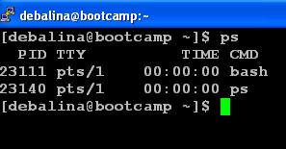
UNIX
Resides between the user and the UNIX system
The shell is a unique and a versatile “program” by itself
It is a command interpreter and a programming language rolled into one
Yes…..it is also a “process” which runs as soon as you have logged in !
Happy user!!!
The "Shell"
Angry user…Operating system needs to be reloaded!
The UNIX user interface is called as the “shell”.
Knowledge grows by sharing

Slide 19
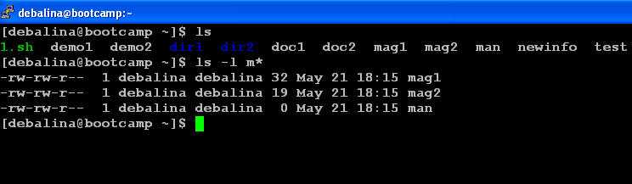
UNIX
The following activities that are performed in course of the shell’s interpretive cycle are :-
  Displays the prompt
  Reads the command issued at the prompt
  Processes/Executes the command
  Waits for command completion
  Displays prompt again
The
Shell's
Interpretive
Cycle
Knowledge grows by sharing

Slide 20
UNIX
There are several different shells available for UNIX, you can use any one of these shells if they are available on your system.
The different shells are:-
  Bourne shell(sh)
  C shell(csh)
  Korn shell(ksh)
  Bourne Again shell(bash)
Different
types of
the UNIX shell
Knowledge grows by sharing

Slide 21
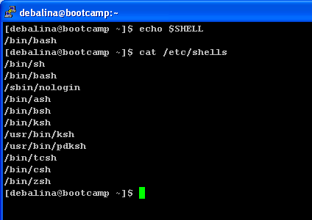
UNIX
Information about which shell you are using is held in the “SHELL” environment variable.
“echo $SHELL” displays the value of this variable.
You can identify which shell you are presently using from the last part of the pathname
"echo $SHELL"
command
Bash shell
Knowledge grows by sharing

Slide 22



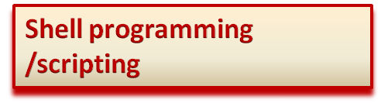


UNIX
Shell provides the following functionalities-
Functions of
a
Shell
Knowledge grows by sharing

Slide 23
UNIX
Users must identify themselves to the system— this is called logging on
At the login: prompt enter the login id and then press Enter (or return)
At the password: prompt enter the password — note that you cannot see what you are typing
To change the password the “ passwd “ command is used
A good password is:
  Cannot be less than 6 or more than 14 characters long
  Uses a mix of uppercase and lowercase letters, numbers, and symbols (e.g. #, %).
Starting a
UNIX session
--Logging In--
Desirable to have slightly complex passwords so that they are not easily deciphered
Knowledge grows by sharing

Slide 24
UNIX
Disconnecting from the system is called “Logging out”
Can be done by :-
    exit
    logout
    ^D
Ending a
UNIX session
-Logging Out-
Knowledge grows by sharing

Slide 25
UNIX
Each user has their own space , called their “account”.
Type the login ID and password to enter into the account.
Only if the login ID and password match shall you be allowed to let in.
login: maverick You type your ID and RETURN.
Password: You type your password and
RETURN. It does not appear.
$ The UNIX prompt . You can now enter commands.
Login to your account
Knowledge grows by sharing

Slide 26
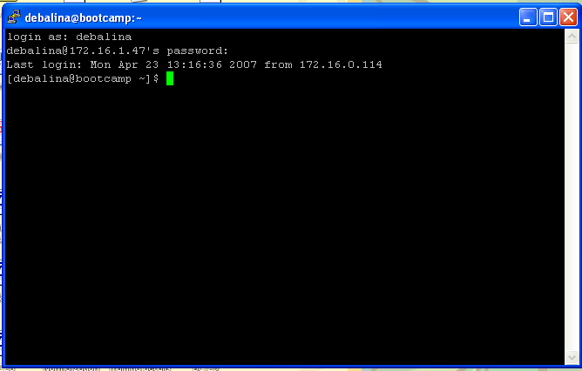
UNIX
The Command
Login names and passwords are case-sensitive…if both are correct then you are allowed to enter into UNIX.
Knowledge grows by sharing

Slide 27





UNIX
Getting started
with
UNIX Commands
Lets start working with the UNIX commands……….
Knowledge grows by sharing
Notes:
.

Slide 28

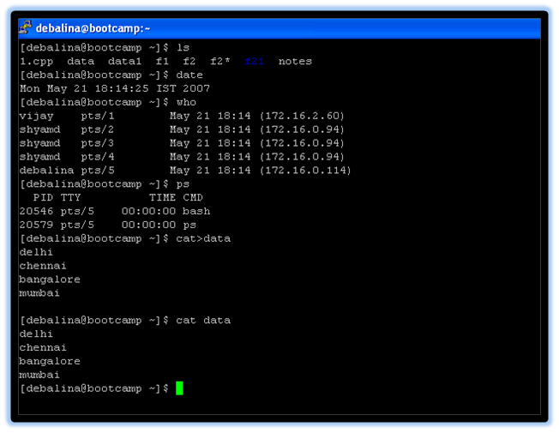
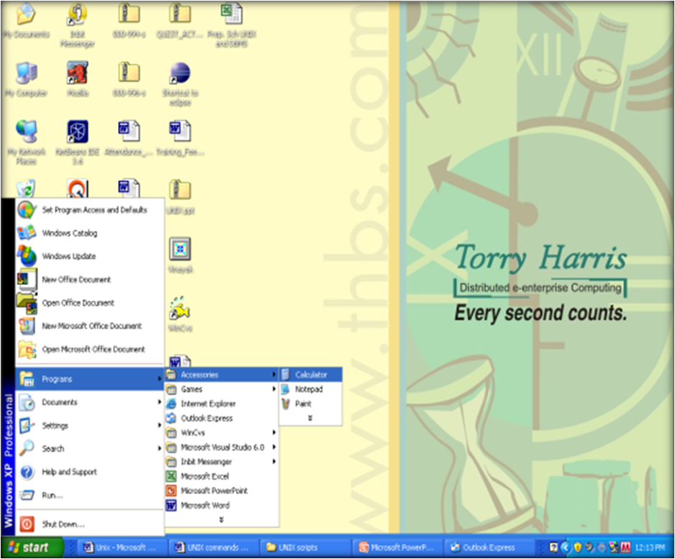

UNIX
Commands
Windows
&
UNIX
GUI elements
Knowledge grows by sharing

Slide 29
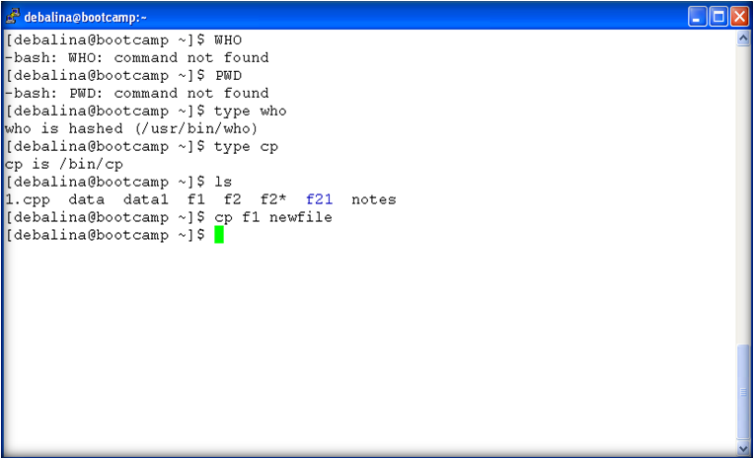
UNIX
Who displays the error message?
Working of UNIX commands
UNIX commands are case sensitive.
Knowledge grows by sharing
Notes:
Explain not to mug/byheart and learn more on the job,use man page

Slide 30

UNIX
cal
date
who
uname
echo
printf
passwd
man
bc
General Purpose
Utilities…
Knowledge grows by sharing

Slide 31
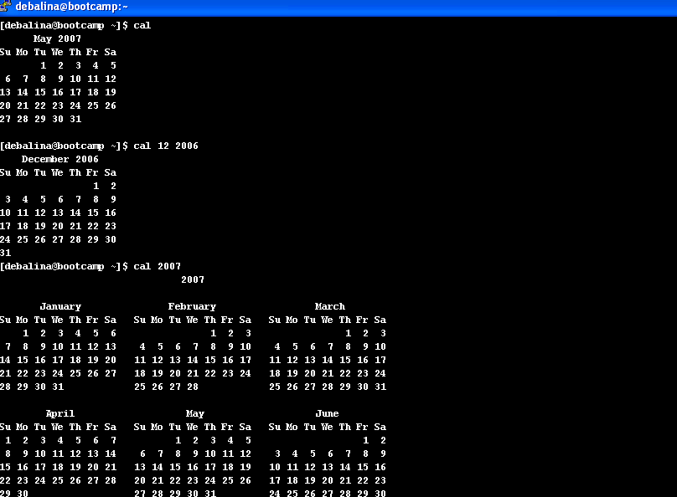
UNIX
The
"cal" command
If “cal” is used with arguments, the month is optional but the year is not.
Knowledge grows by sharing

Slide 32
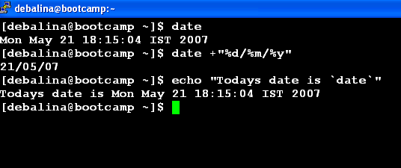
UNIX
The
"date"
command
Command Substitution
Ordinary user cannot change the date; only the system administrator can do so
Knowledge grows by sharing

Slide 33
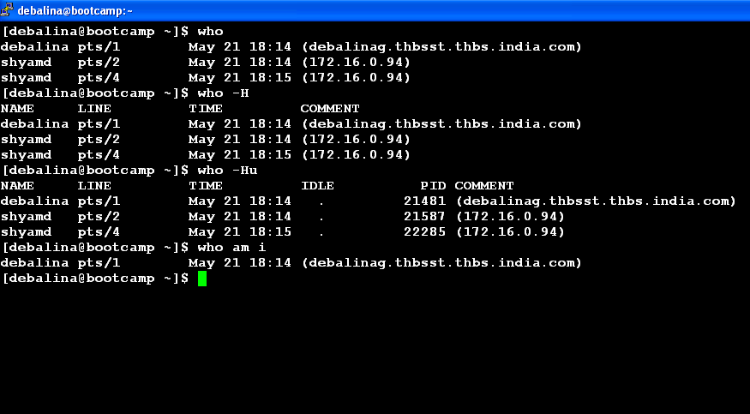
UNIX
The
"who"
command
“who” command by itself does not display header information, only does so by using the –H option.
Knowledge grows by sharing

Slide 34
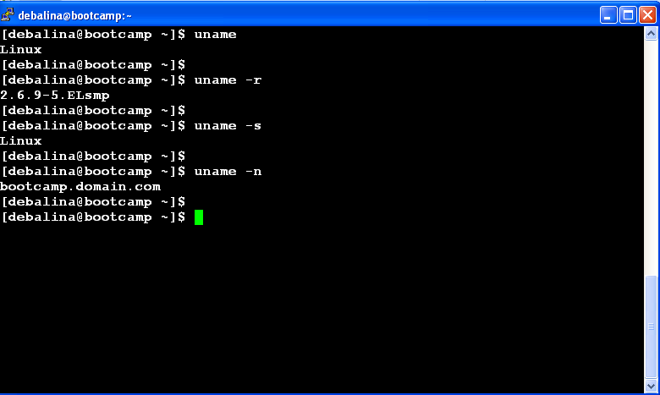
UNIX
The
"uname"
command
Retrieves the operating system characteristics
Knowledge grows by sharing

Slide 35
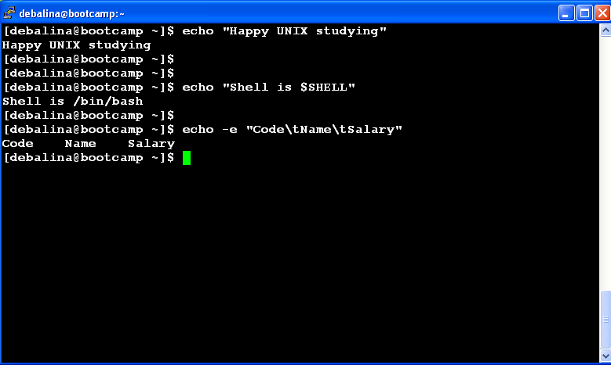
UNIX
The
"echo"
command
Bash ,the standard shell in Linux, interprets escape sequences only with the use of the –e option with echo command
Knowledge grows by sharing

Slide 36
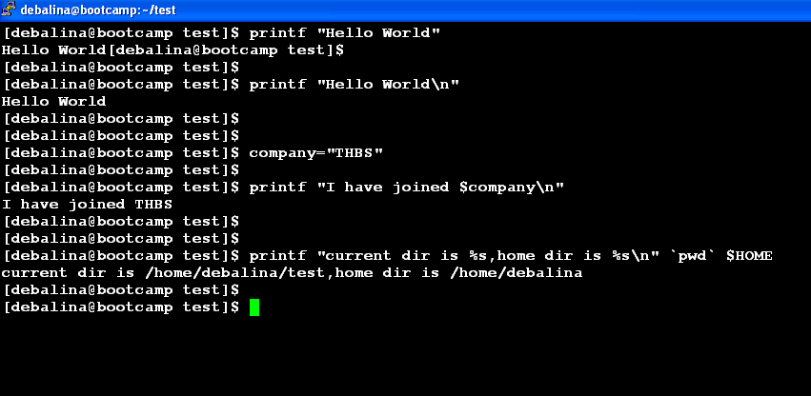
UNIX
The
"printf"
command
Knowledge grows by sharing

Slide 37
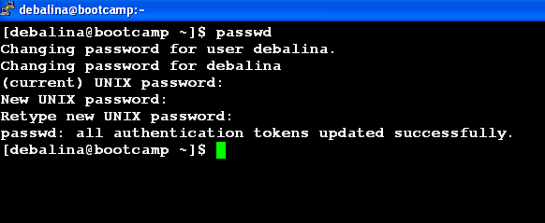
UNIX
The
"passwd"
command
Knowledge grows by sharing

Slide 38
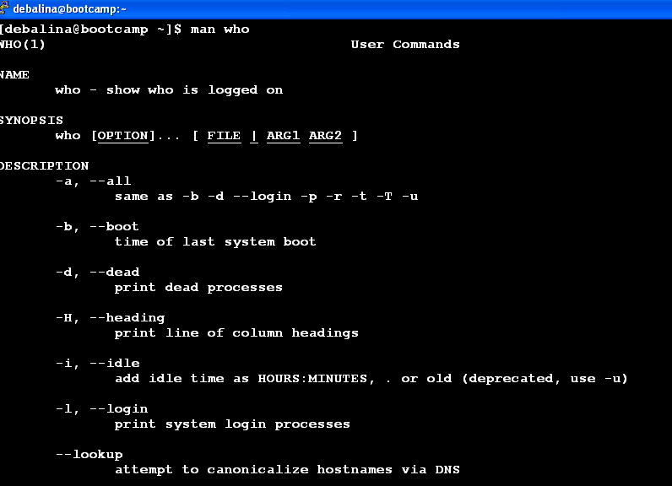
UNIX
The
"man"
command
Use “$man man” to see how “man” is used
Knowledge grows by sharing

Slide 39


UNIX
UNIX provides a text based calculator-using the “bc” command
“bc” belongs to a family of commands that expect input from keyboard and displays output on the screen
By default, “bc” performs only integer computation and truncates decimal portion that it sets.
To enable floating point computation, you would need to set the scale to the number of digits of precision
The
"bc"
command
Knowledge grows by sharing

Slide 40
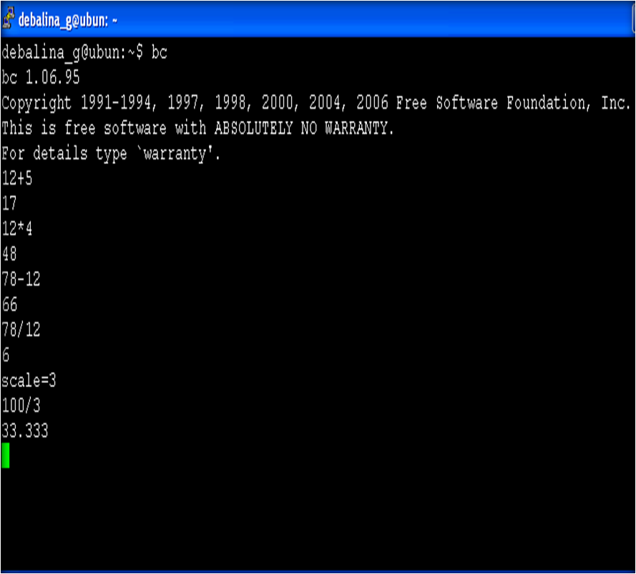
UNIX
The
"bc"
command
Knowledge grows by sharing

Slide 41

Knowledge grows by sharing

